Slide 1


A Quick presentation on tiledb
https://tiledb.io/

Slide 2

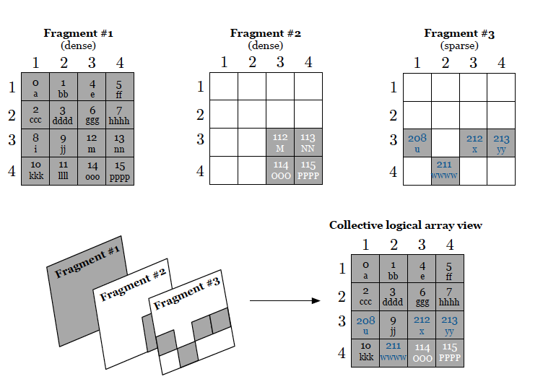
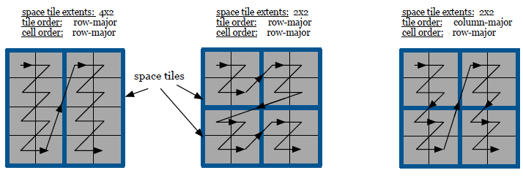
Overview
Novel Storage Manager
Sparse and Dense Array Management
Fragments
Data Tile
Read/Write – Biggest Applications
Sequential Write
Random Write
Parallelism
Multi-Threading
Multi-Processing

Slide 3
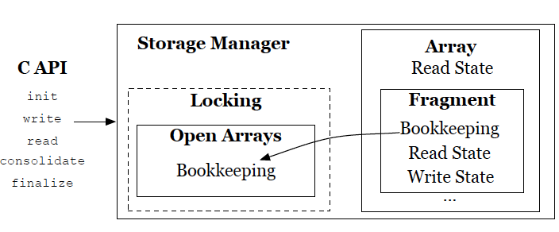
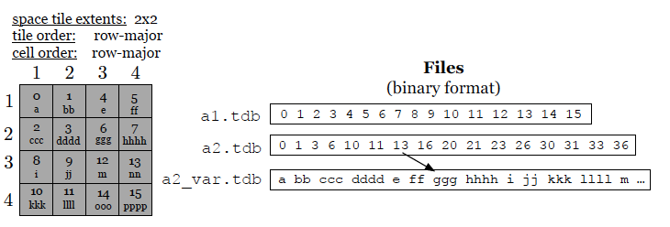
Workflow
C, C++, Ruby, Python +
Novel Dense Tools
Compression
Parallelism
Arbitrary Dimensionality & Array Schema
Revisiting Fragments
Why Don’t all big Data Managers utilize fragments?
Most actually use SQL Where
How does Performance Work?

Slide 4
My Work This semester
_Array 1: 100% cells are non-empty values;
_Array 2: Only the first 10% of consecutive cells are non-empty values;
_Array 3: Only the first 50% of consecutive cells are non-empty values;
_Array 4: Only the last 10% of consecutive cells are non-empty values; and
_Array 5: 10% of random cells are nonempty values.
10x bigger than OS memory

Slide 5
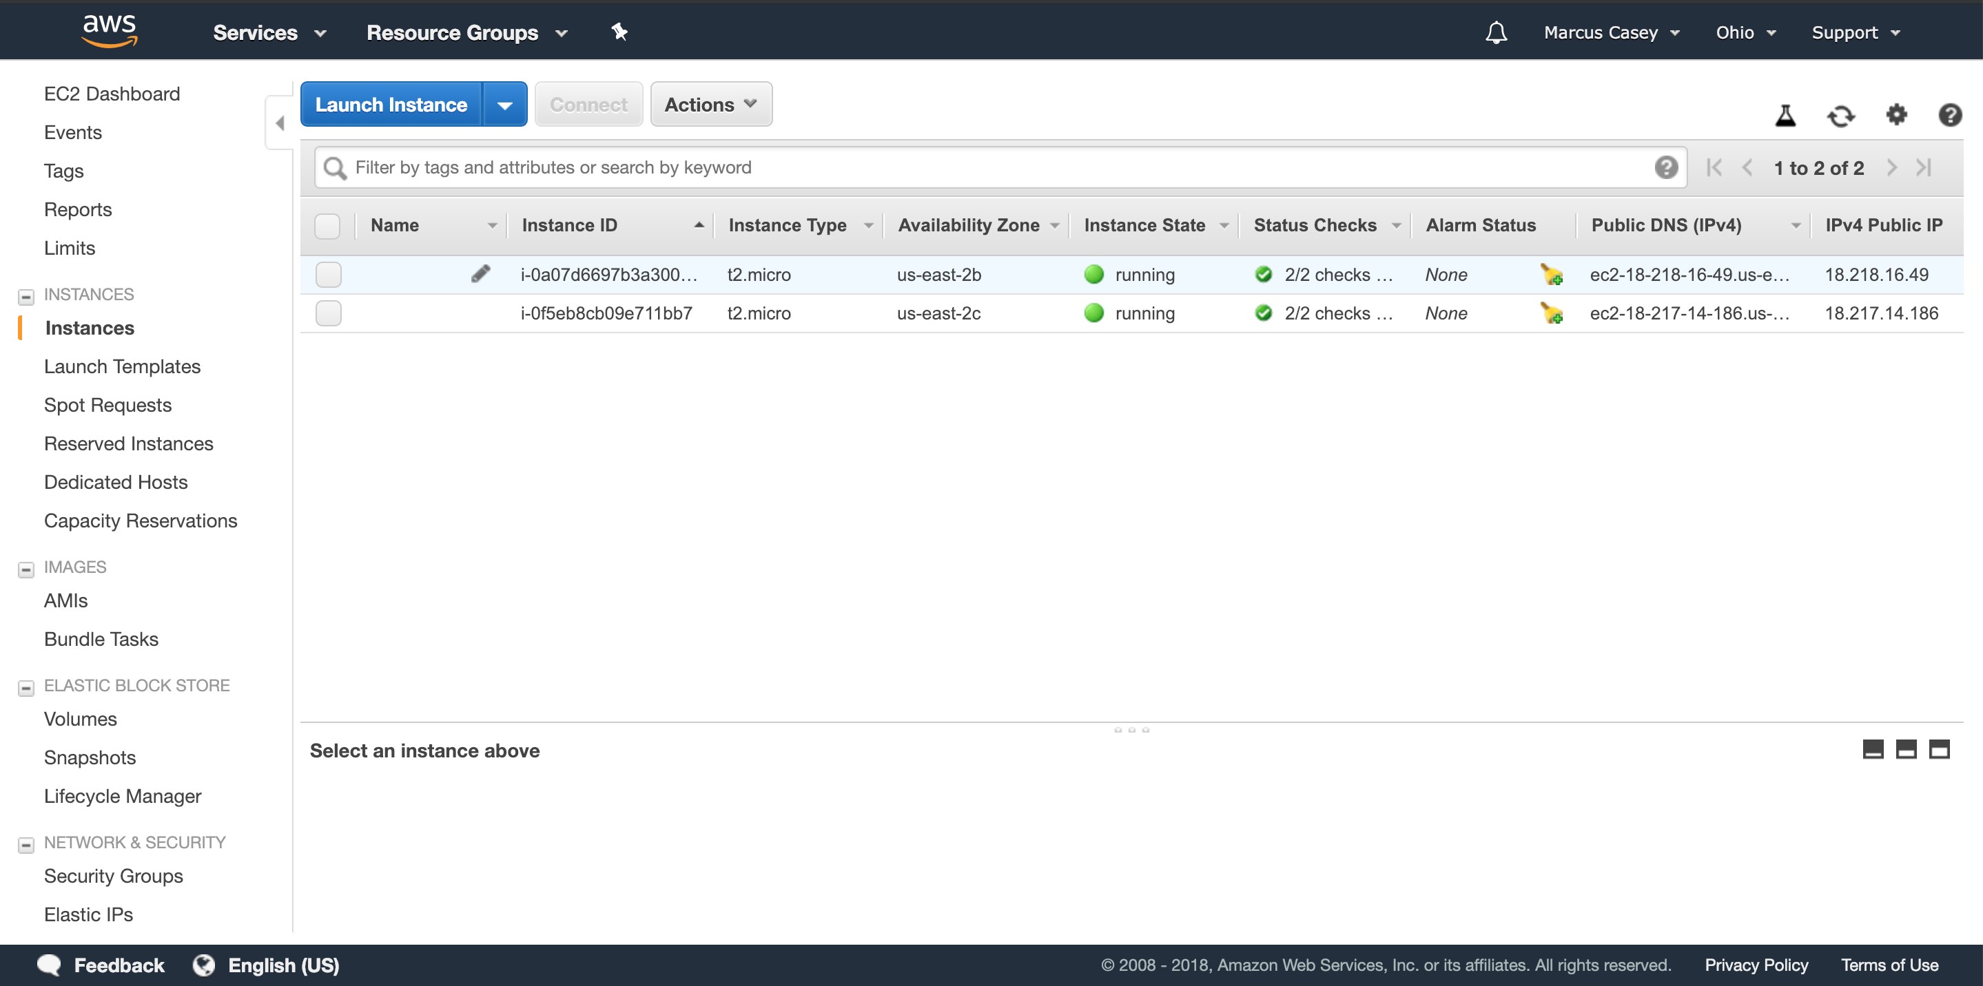
AWS

Slide 6
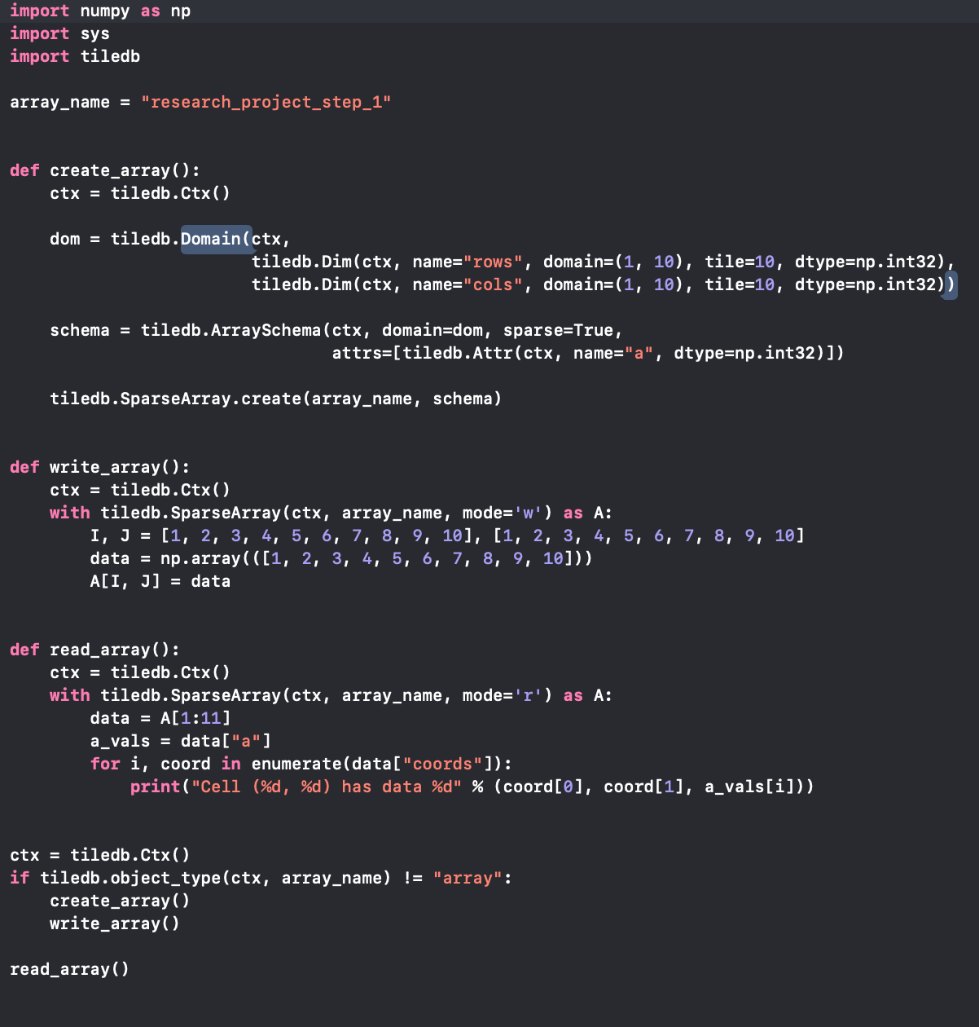
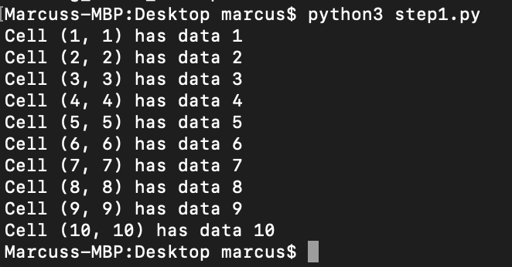
Code Example

